Slide 1
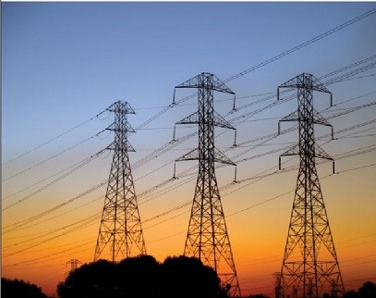
VIDYUT RAKSHAK: POWER LINE INSPECTION ROBOT
GNANESHWAR ADAPA

Slide 2
Power Line
A power line is a physical structure used to transmit electricity from a power source, such as a power plant or substation, to consumers.
Distribution lines typically operate at lower voltages, ranging from 120 volts for residential service (use split phase system) to a few kilovolts for commercial or industrial service.
Transmission lines carry voltages ranging from 345 kV to 765 kV- EHV, and possibly higher for Ultra High Voltage (UHV) or High Voltage Direct Current (HVDC) lines.

Slide 3
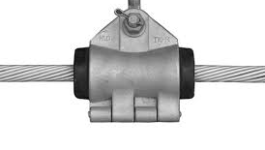
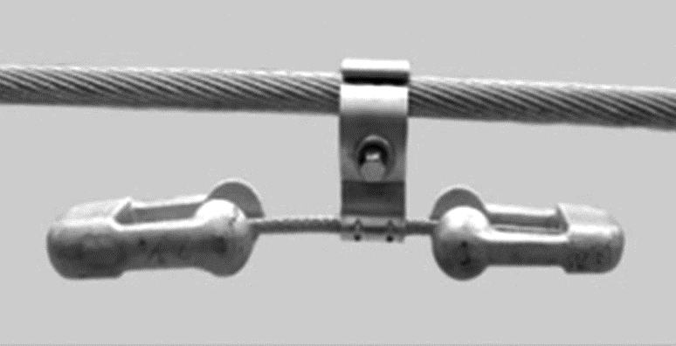
SUSPENSION CLAMPS AND VIBRATION DAMPERS
These are essential components used in high-voltage power transmission lines to ensure stability and reliability.
Suspension Clamps:
Support the weight of conductors between transmission towers and Maintain proper sag and tension in the conductors for efficient electricity transmission.
Vibration Dampers:
Reduce wind-induced oscillations along the conductor and minimize fatigue stress on the transmission line components.
Over time, nuts and bolts securing these components may loosen due to factors like vibration, thermal effects, material wear, corrosion, or improper installation.
Fig 1: Suspension clamp
Fig 2: Vibration damper

Slide 4
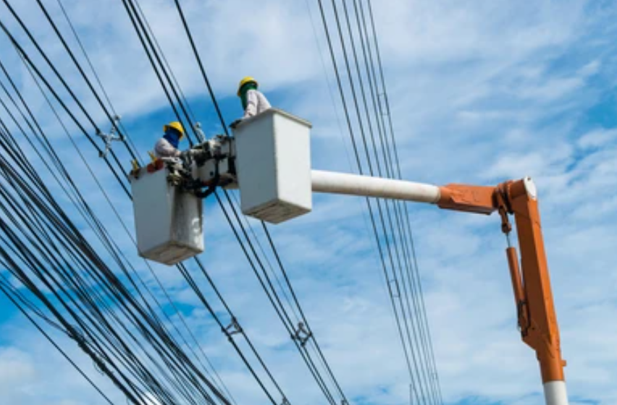
Power Line Inspection
The physical inspection of power lines is conducted to identify potential issues such as wear, damage, corrosion, or other abnormalities that could compromise the safety, reliability, and efficiency of the electrical transmission and distribution system.
Power transmission line inspection duties are performed manually to examine the condition of the high voltage power transmission lines in operation and identify any defects. High voltage power transmission line equipment is still currently inspected manually .

Slide 5
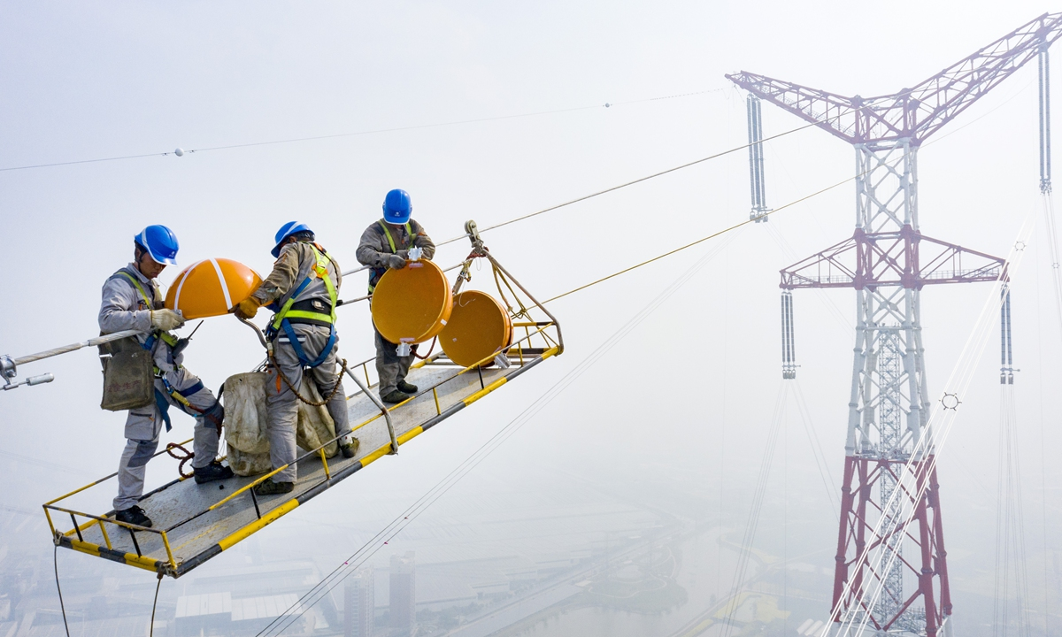
PROBLEM:-
According to media reports and studies, transmission line inspection can be a dangerous job in India, and there have been fatalities associated with this line of work.
Nearly 11,000 deaths every year, or 30 fatalities every day! Electrocution deaths have increased a whopping 50 per cent from 8,945 in 2011 to 13,446 in 2021
Drawbacks include lengthy inspection cycle, high levels of working stress, high costs, and increased risk.

Slide 6
SOLUTION:-
In general, inspecting high-voltage power lines is a very dangerous and challenging task. Therefore, we created a robot that will examine the power lines. The robot will be positioned over the power lines. By shifting the direction, it checks the power line.
Using the camera's rotating mechanism, it examines the power line. Using the pan and tilt servo assembly, we can control the rotation of the camera. The robotic arm, which is operated by hand gestures, can also be used to adjust the bolts which are used for power lines in a correct way.

Slide 7
COMPONENTS AND SOFTWARE USED
Components:-
DC motors
Pulley wheels
ESP32CAM
Bluetooth module hc05
Arduino mega2560
Motor driver l298n
Lithium ion battery
Flex sensor
Servo motor
Software:- Arduino IDE, Fusion 360, Fritzing.

Slide 8
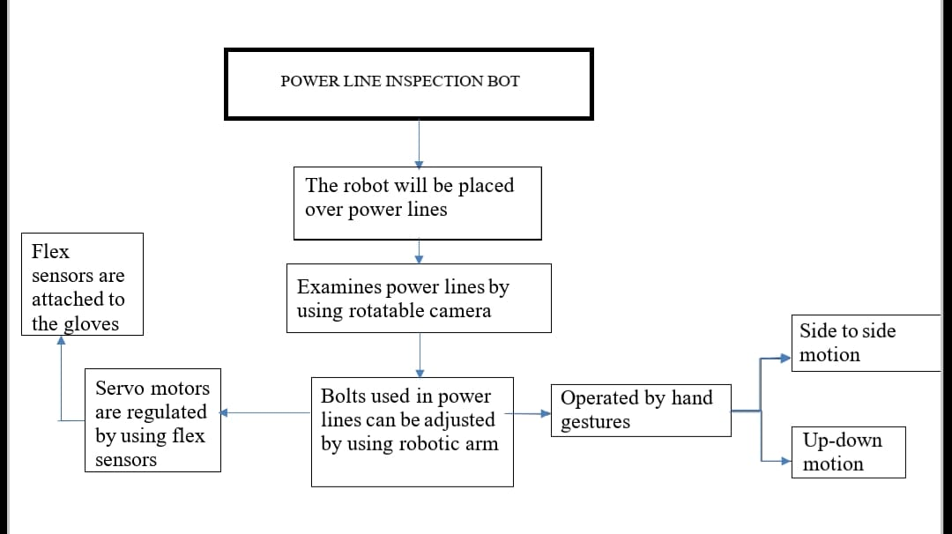
WORKING/BLOCK DIAGRAM:-

Slide 9
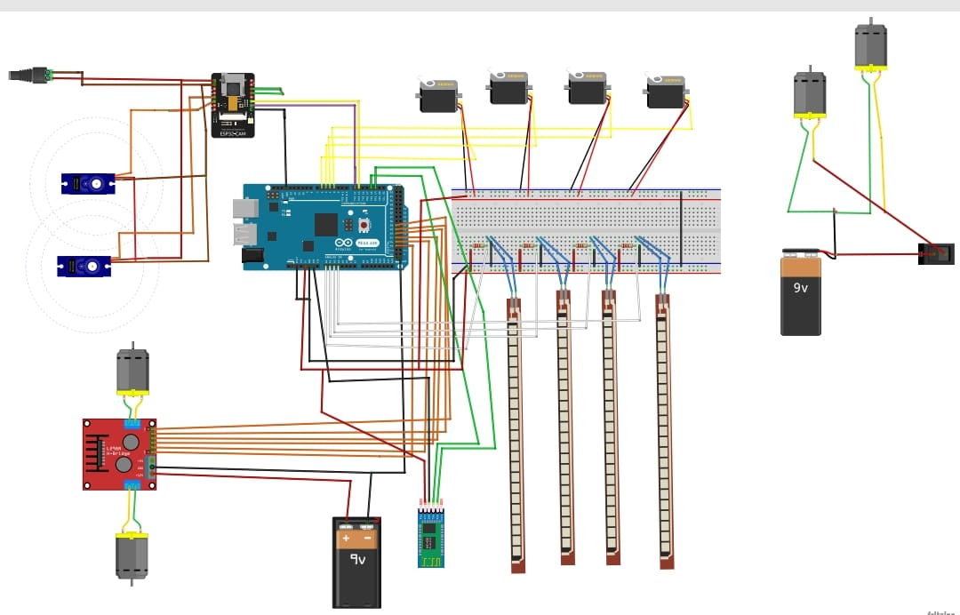
CIRCUIT DIAGRAM:-

Slide 10
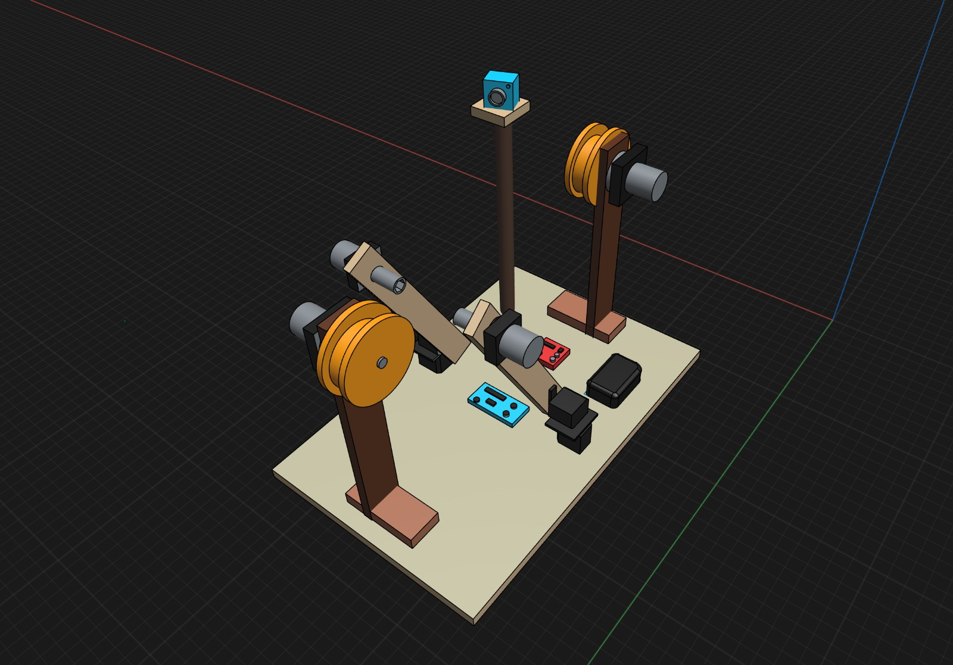
CAD MODEL:-

Slide 11
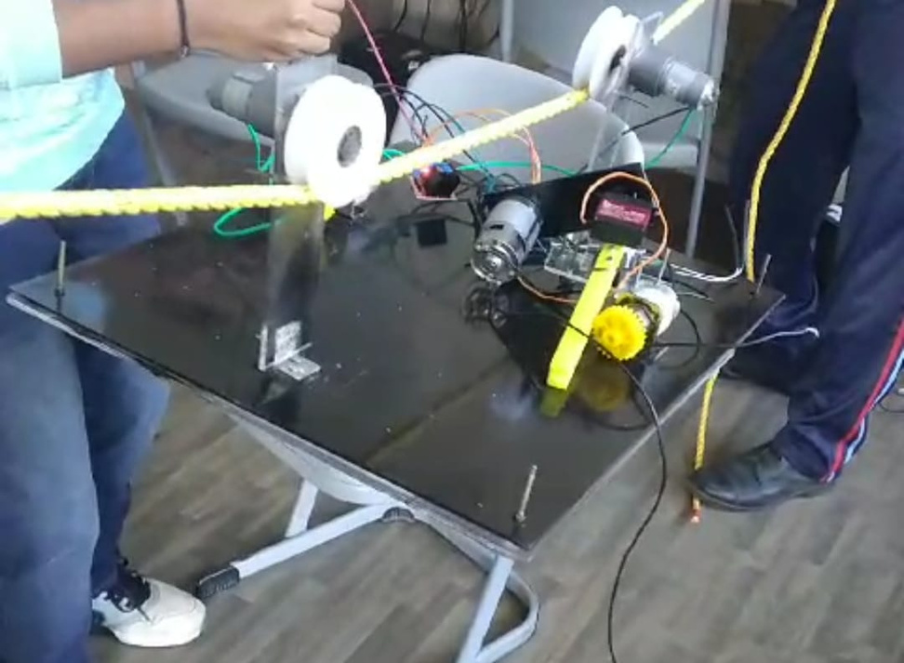
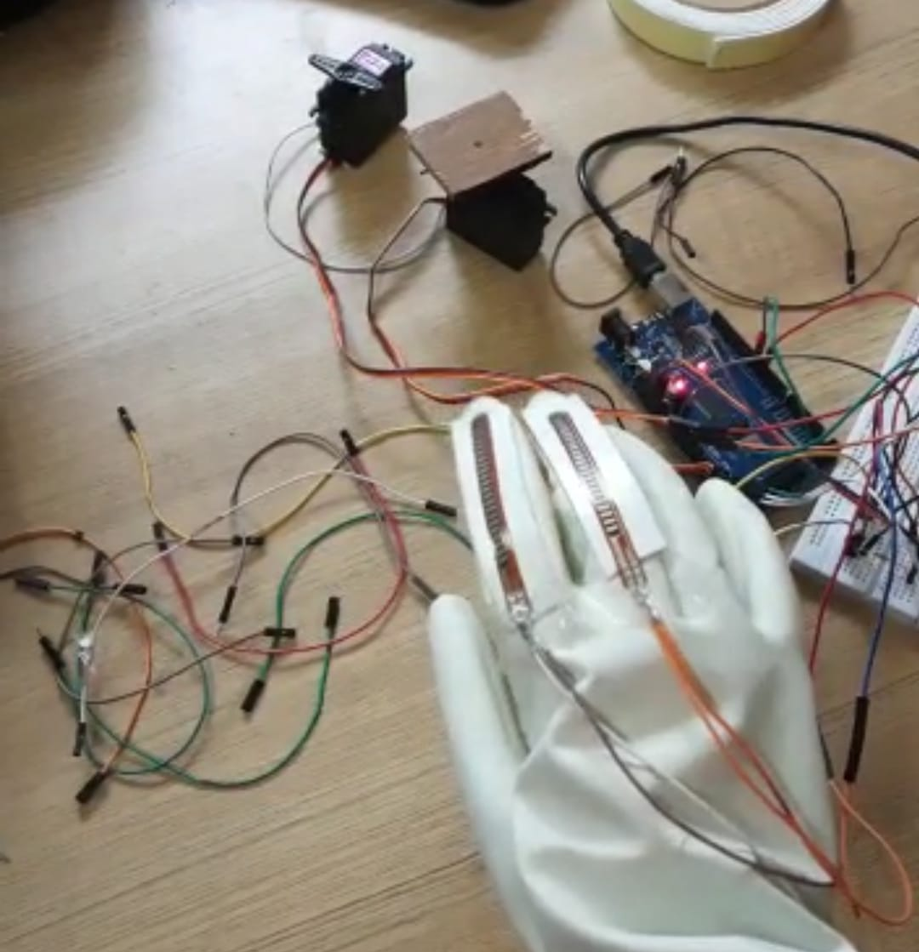
PROTOTYPE:-

Slide 12
ECONOMICS:-
Cost of the prototype:-Rs.10,000
While implementing it to product level and adding extra features:Rs.2,50,000(approx).
Basically it is helpful for power utility companies.
Number of transmission line stations :9000(India) and 3,50,000(Worldwide).
Generally used in government sector.
10 units per station cost:Rs.25,00,000

Slide 13
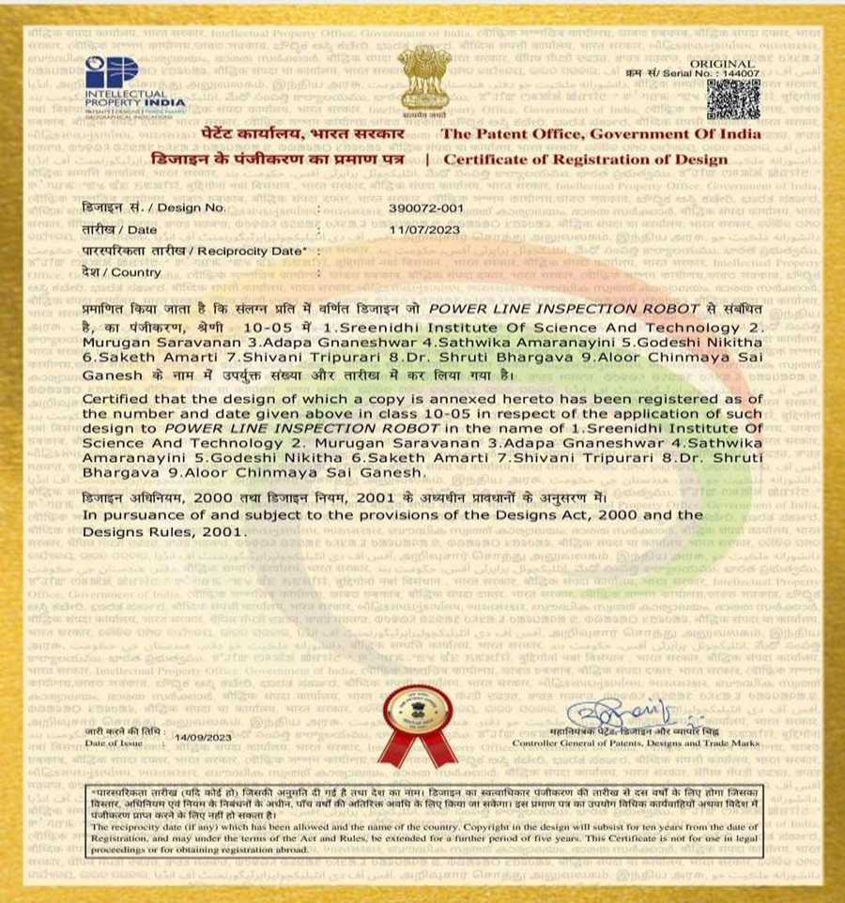
DESIGN PATENT:-

Slide 14
CONCLUSION:-
This transmission line inspection robot would eliminate the need for human labour , increasing efficiency and accuracy. This project will also ensure the safety of human operators by completely balancing its own machine body on parallel wires, and it will cause no harm to the environment or surroundings.

Slide 15

Thank you

